Slide 1


Analysis of early hematopoiesis aging with single cell RNA-seq
Supervisor:
Elisabeth REMY
I2M- UMR7373
Co-supervisor:
Estelle DUPREZ
CRCM-Inserm U1068
Léonard HERAULT

Slide 2

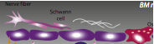
Biological context
Microenvironnement
Young HSC
Aging
Differentiation
Normal hematopoiesis

Slide 3
Biological context
Microenvironnement
Young HSC
Aging
Self-renewal
Differentiation
Normal hematopoiesis

Slide 4

Biological context
Microenvironnement
Microenvironnement
Young HSC
Old HSC
Aging
+++
Self-renewal
Differentiation
Self-renewal
Altered Differentiation
Normal hematopoiesis
Myeloid hemopathies

Slide 5
Biological context
Microenvironnement
Molecular mechanisms?
Microenvironnement
Young HSC
Old HSC
Aging
population changes?
+++
Self-renewal
Differentiation
Self-renewal
Altered Differentiation
Normal hematopoiesis
Myeloid hemopathies

Slide 6
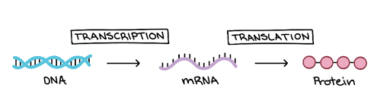
Central dogma of molecular biology
DNA: “master blueprint”, contains all genetic info of an organism. Must be protected; therefore it never leaves the nucleus.
RNA: “temporary blueprint”, copies small portions of DNA and can leave nucleus to synthesize proteins at the ribosome.
Proteins: primary building block of organisms. A macromolecule made of linked monomers called amino acids.
Léonard HERAULT

Slide 7
Central dogma of molecular biology
What we measure
DNA: “master blueprint”, contains all genetic info of an organism. Must be protected; therefore it never leaves the nucleus.
RNA: “temporary blueprint”, copies small portions of DNA and can leave nucleus to synthesize proteins at the ribosome.
Proteins: primary building block of organisms. A macromolecule made of linked monomers called amino acids.
Léonard HERAULT

Slide 8
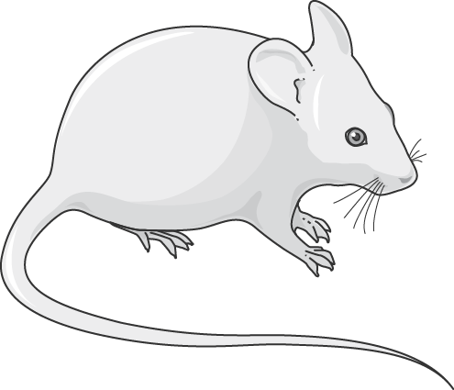
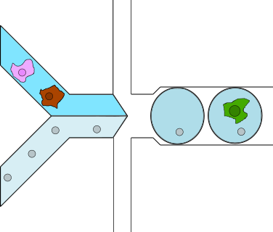
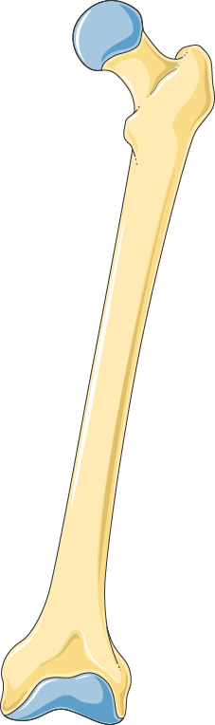

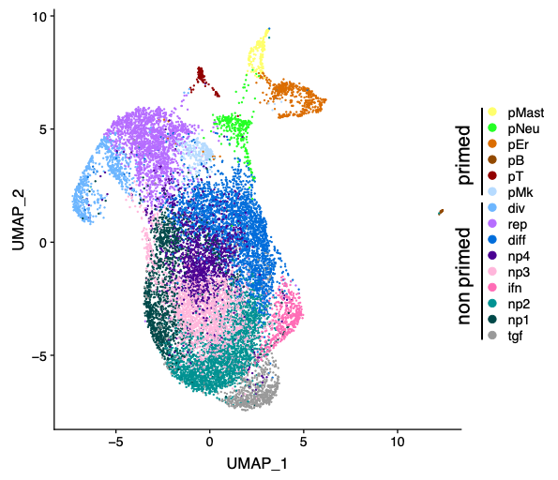
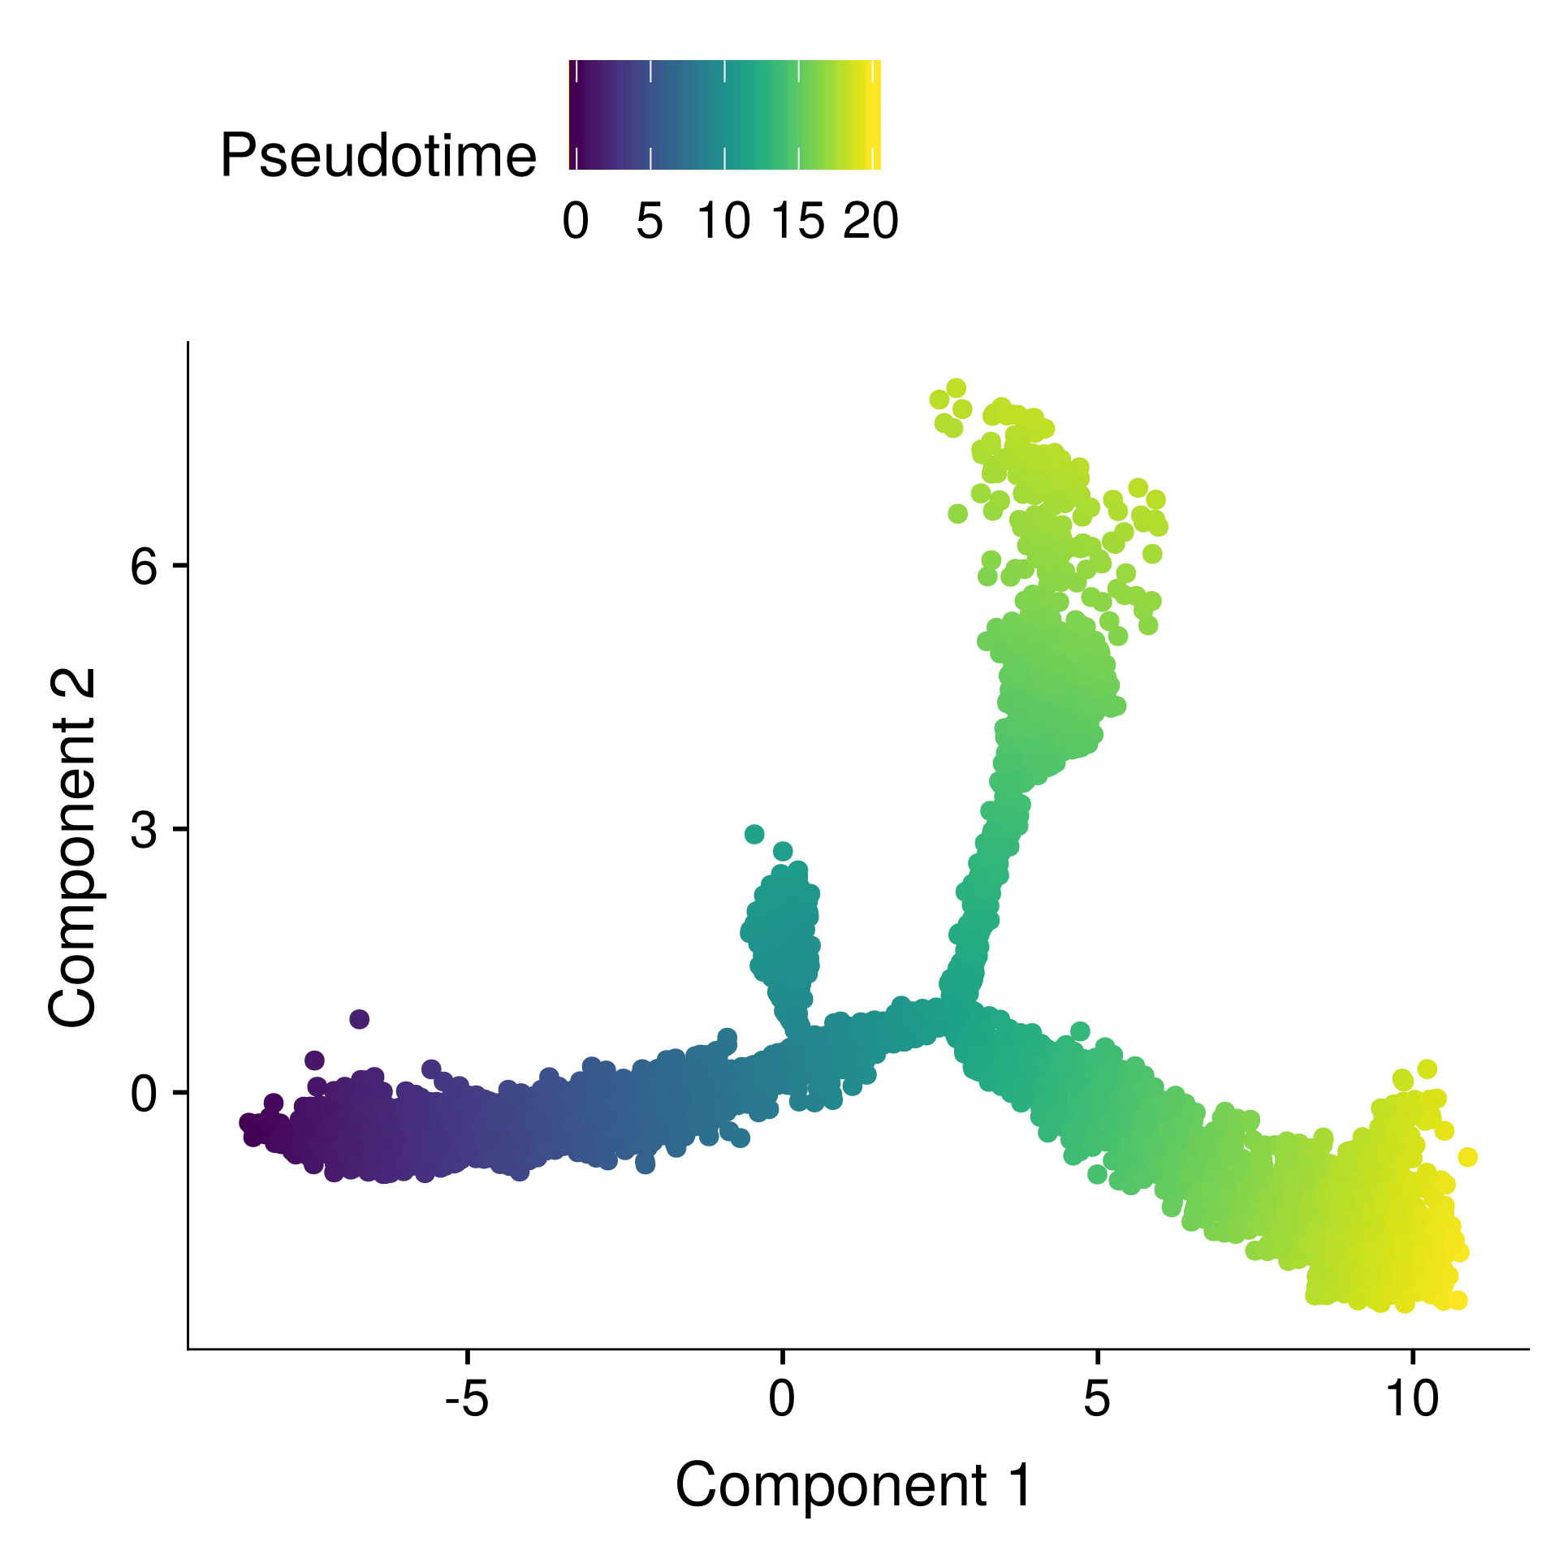
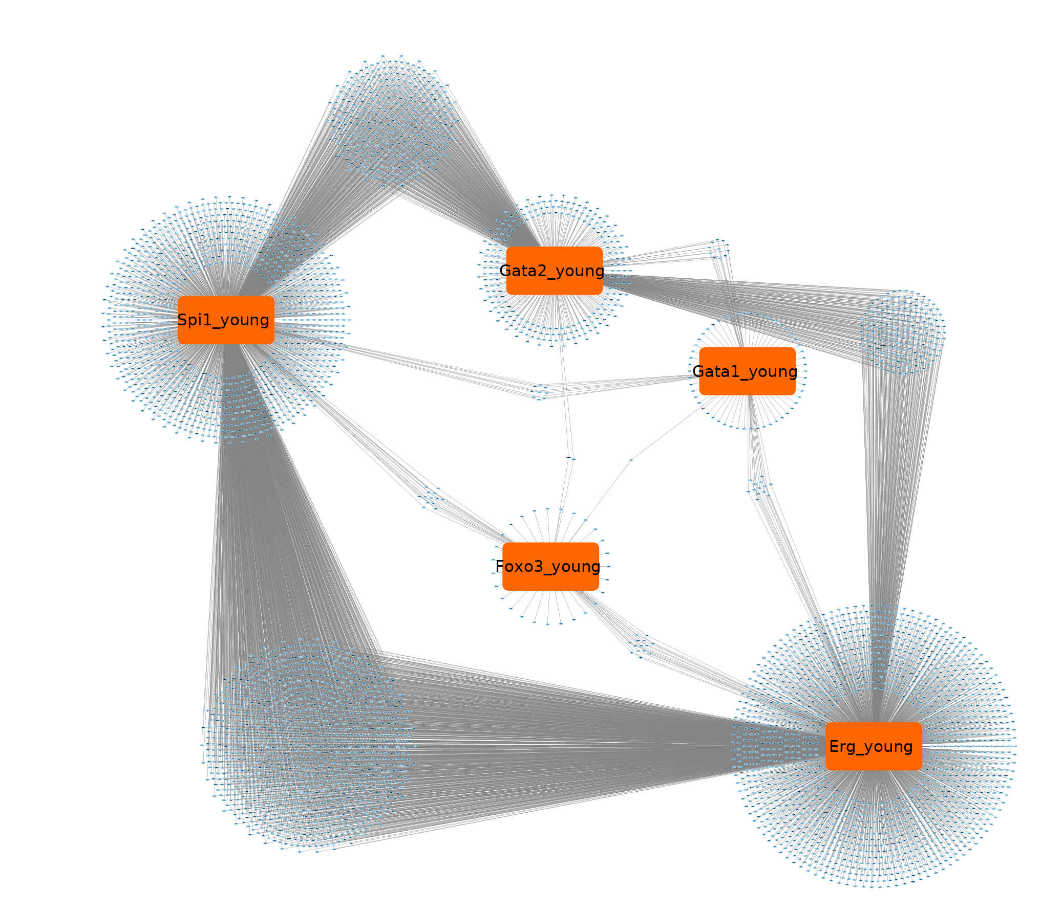
Strategy overview
Isolation of total bone marrow cells
HSPCs Sorting
LSK, FLT3-
Oil
Single cell capture
Cells
Young mice
Beads
Oil
Old mice
 | Cell 1 | Cell k | Cell n
Gene 1 | 0 | 0.7 | 3.8
Gene k | 3.2 | 0 | 0
Gene m | 0 | 5.1 | 0
Sample integration, cell clustering
Pseudotime ordering
Regulon analysis
n = 15 000 (1/2 young, 1/2 old)
m = 10 000

Slide 9
Pseudotime ordering
Stem cell
Differentiated cell
Campbell, Kieran & Yau, Christopher. (2016)

Slide 10
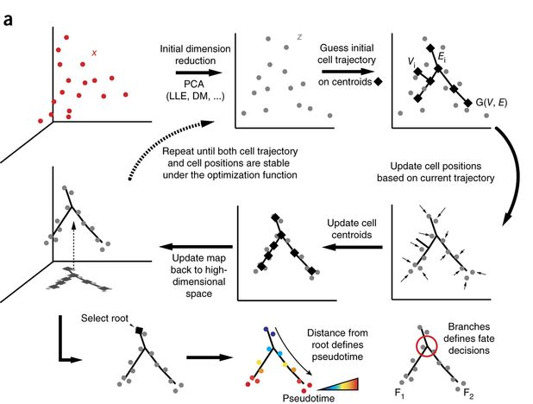
Pseudotime ordering

Slide 11
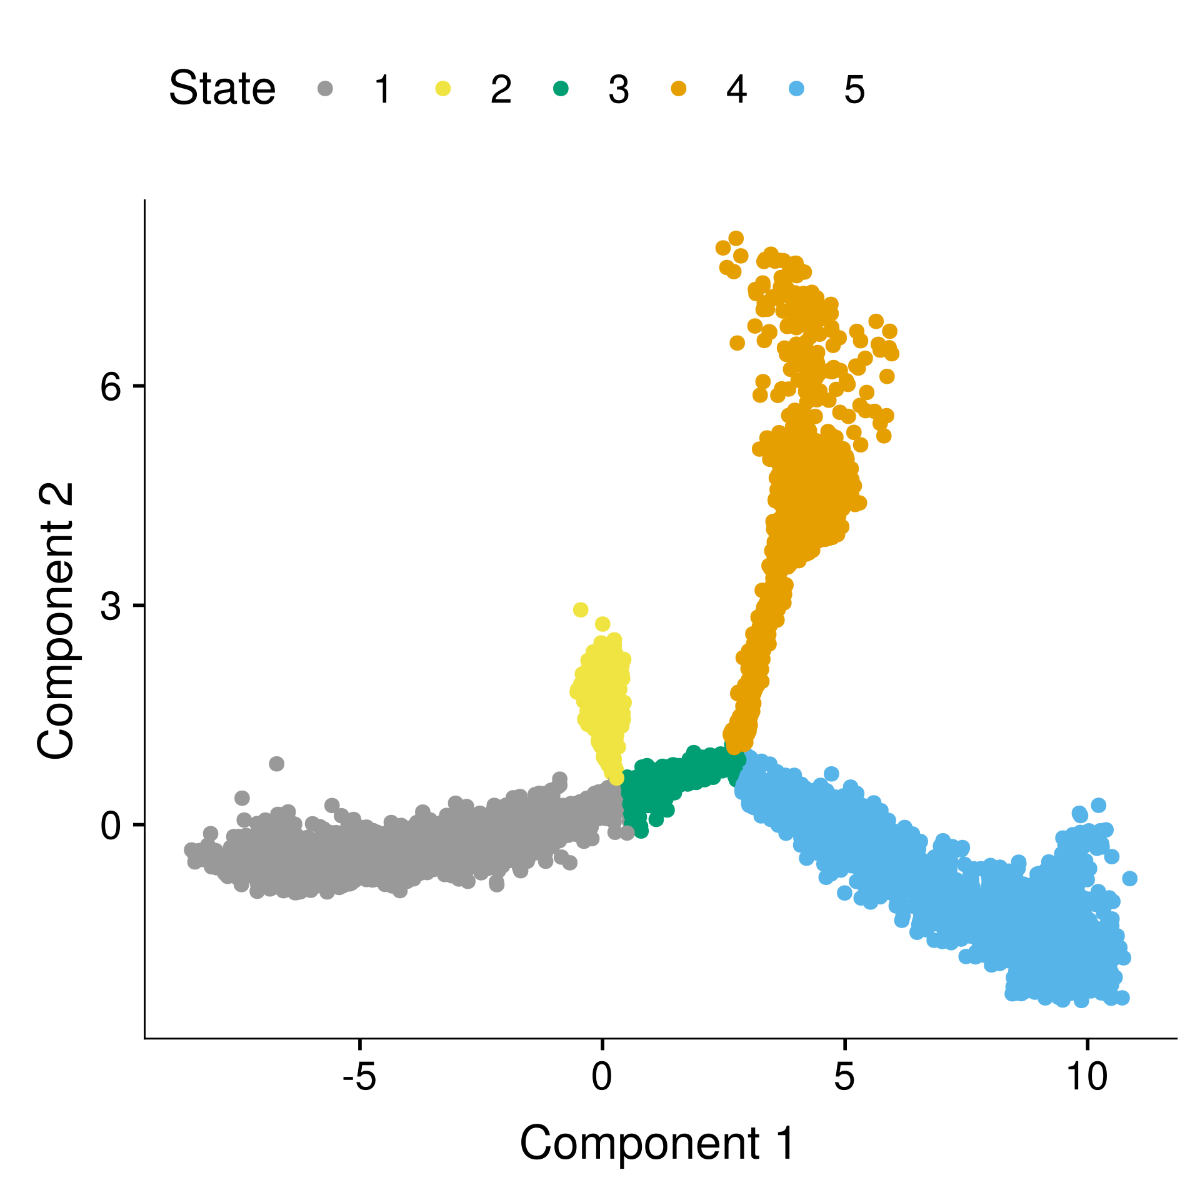
Results

Slide 12
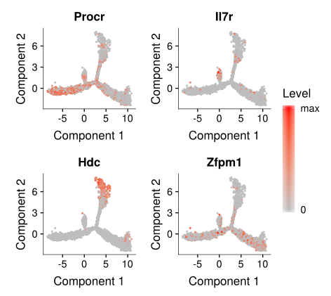
Results

Slide 13
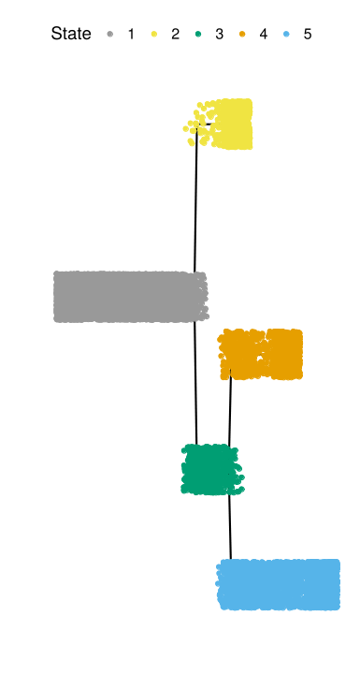
Results
T
p
NM
pM
ME
Pseudotime

Slide 14
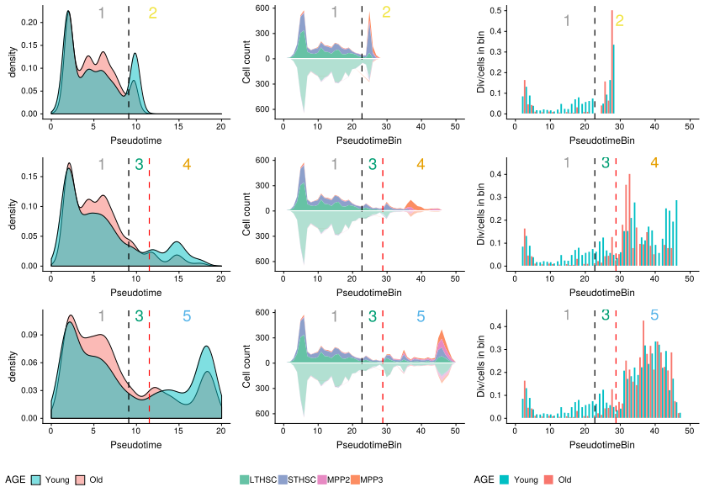
Results
T
p
NM
pM
ME
Pseudotime

Slide 15
Results
T
p
NM
pM
ME
Pseudotime

Slide 16
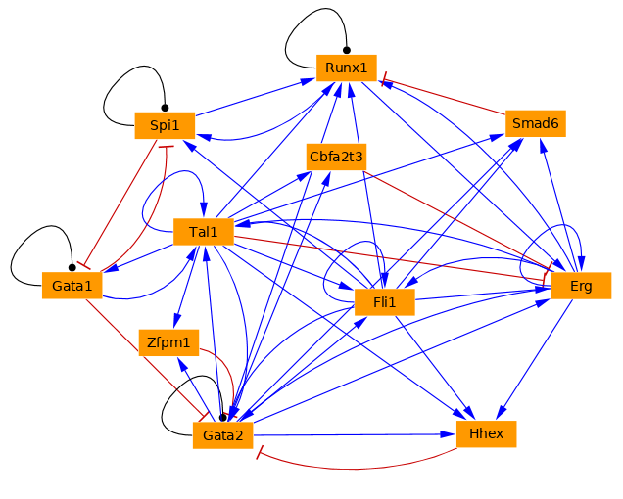
Boolean modelling of the early hematopoiesis aging
Single cell data:
Young/old
Boolean model specification and parameterization
Litterature,
ChIP-seq data
f(G1) = !G2
f(G2) = G1
…
G1
G2
Bonzani et al 2013

Slide 17
Boolean modelling of the early hematopoiesis aging
Single cell data:
Young/old
Boolean model specification and parameterization
Simulations,
Validation analyzes (aging)
Litterature,
ChIP-seq data
f(G1) = !G2
f(G2) = G1
…
0 0
0 1
G1
G2
1 0
1 1
Bonzani et al 2013

Slide 18
Boolean modelling of the early hematopoiesis aging
Data space
Model state space
 | C1 | C2 | Ck | Cn
G1 | 0 | 1.5 | 0.7 | 3.8
Gk | 3.2 | 0.1 | 0 | 0
Gn | 0 | 1.6 | 5.1 | 0
 | S1 | S2 | Sk | Sn
G1 | 0 | 1 | 0 | 1
Gk | 1 | 0 | 0 | 0
Gn | 0 | 1 | 1 | 0
Single cell data:
Young/old
Boolean model specification and parameterization
Simulations,
Validation analyzes (aging)
Litterature,
ChIP-seq data
f(G1) = !G2
f(G2) = G1
…
0 0
0 1
G1
G2
1 0
1 1
Bonzani et al 2013

Slide 19
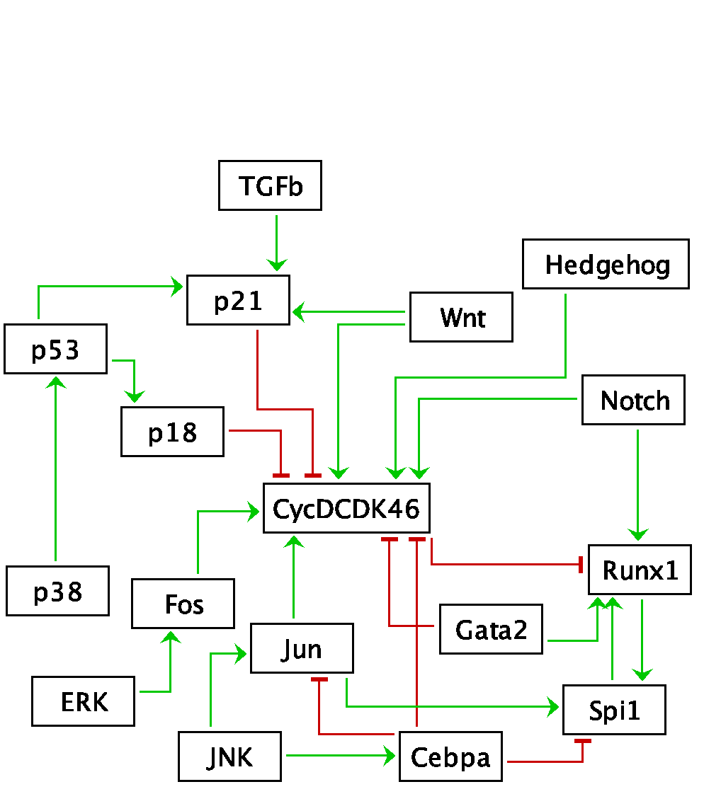
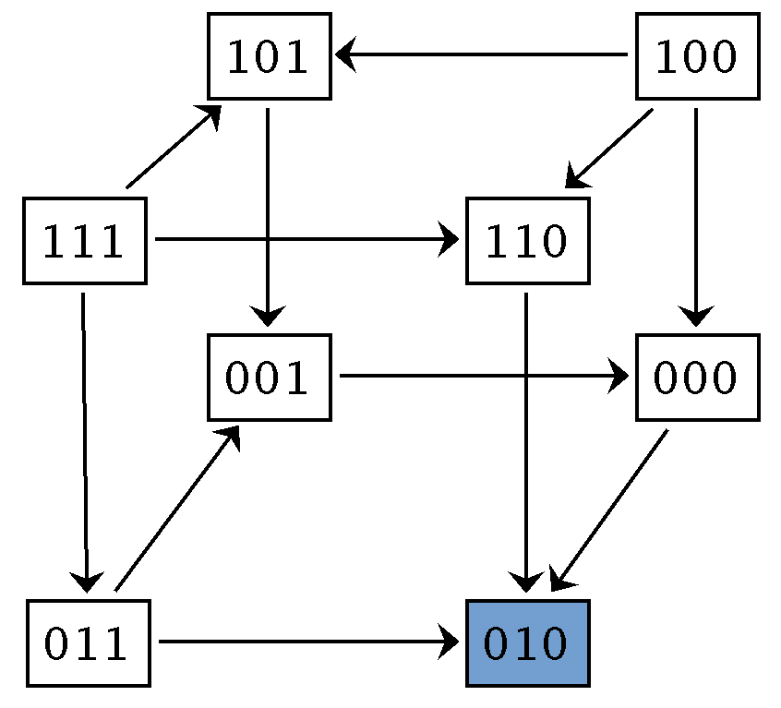
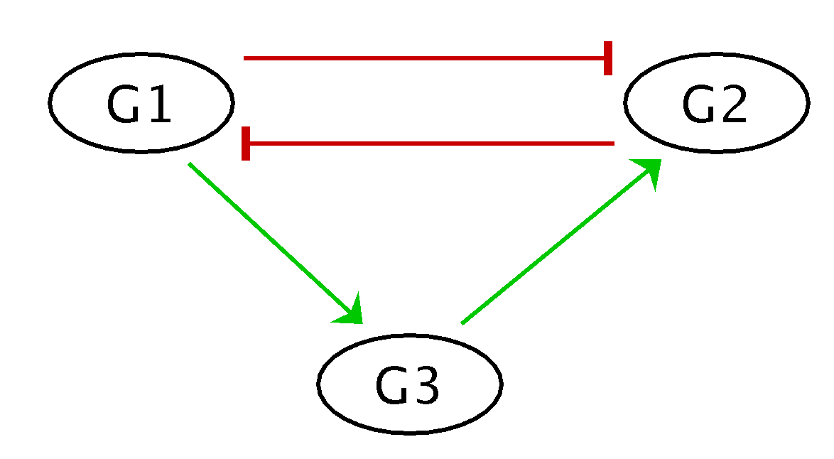
Single cell data Young/Old
Model state space
Stress Hypoxia
Morphogens
 | C1 | C2 | Ck | Cn
G1 | 0 | 1.5 | 0.7 | 3.8
Gk | 3.2 | 0.1 | 0 | 0
Gn | 0 | 1.6 | 5.1 | 0
Simulations,
Validation analyzes (aging)
Litterature,
Pathways,
ChIP-seq data,
models
Boolean model specification and parameterization
TF network
Bonzanni (2013) BTR , Scenic
f(G1) = !G2
f(G2) = G3 & !G1
f(G3) = G1
MAPK
Modelling strategy
Interaction map

Slide 20
Morphogens
Stress
Wnt
Hedgehog
p21
p53
p18
Notch
CycD-CDK4/6
p38
Runx1
Fos Jun
Gata2
MAPK
Cebpa
TF network
Bonzanni (2013)
BTR
Scenic
ERK

Slide 21
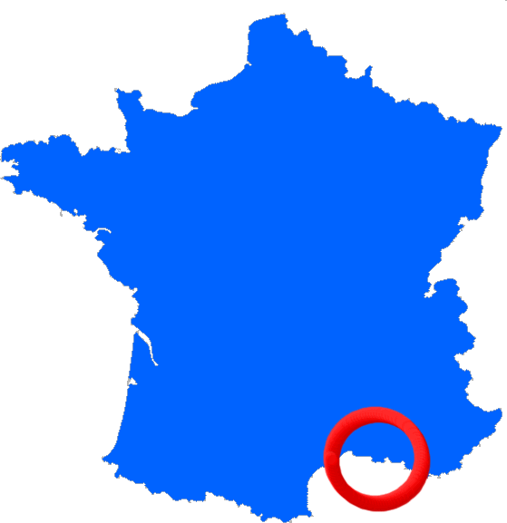
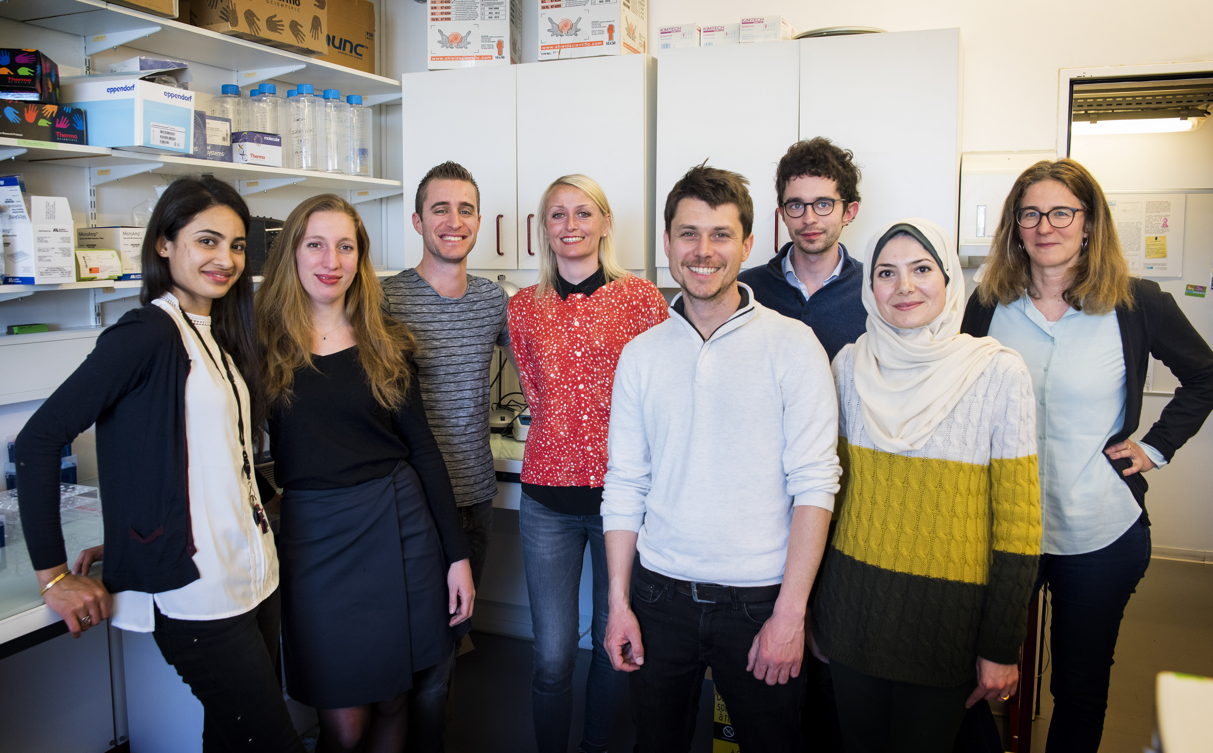
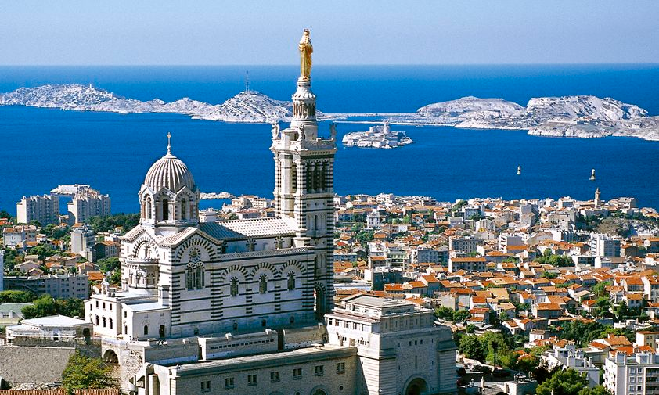
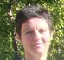
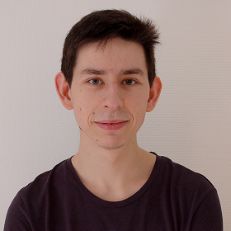











Epigenetics in normal and malignant hematopoiesis
Estelle DUPREZ
Boris CALMELS
Christian CHABANNON
Sylvain GARCIAZ
Lia N’GUYEN
Nadine PLATET
Mathilde POPLINEAU
Loreen HABOUB
Adrien MAZUEL
Sara KARAKI
Ex
Bochra ZIDI
Julien VERNEREY
I2M cluster
Olivier Chabrol
DISC Platform
Bernard CHETRIT
Service d’Onco-hémato
Norbert VEY
Jihane PAKRADOUNI
Mathématiques et Algorithmique pour la Biologie des Systèmes (BMA-MABioS)
Elisabeth REMY
Claudine CHAOUYA
Anaïs BAUDOT
Laurent TICHIT
Brigitte MOSSÉ
Alain GUÉNOCHE
Léo LOPEZ
Stephen CHAPMAN
Firas HAMMAMI
Eva-maria NOVOA DEL TORO
Saran PANKAEW
Ex
Alberto Valdeolivas

